Slide 1
Erlang's loss system and B -formula

Slide 2
Intro...
Erlang's B-formula is based on the model, described by the three elements structure, strategy, and traffic.
Structure: We consider a system of n identical channels (servers, trunks, slots) working in parallel.
This is called a homogeneous group.
Strategy: A call arriving at the system is accepted for service if at least one channel is idle.
Every call needs one and only one channel. We say the group has full accessibility.

Slide 3
Cont...
If all channels are busy the system is congested and call attempts are blocked.
A blocked (= rejected, lost) call attempt disappears without any after-efect as it may be accepted by an alternative route.
This is called Erlang's loss model or the Blocked Calls Cleared = BCC{model

Slide 4
Within a full accessible group we may look for an idle channel in different ways:
Random hunting: we choose a random channel among the idle channels.
On average every channel will carry the same traffic.
Ordered hunting: the channels are numbered 1; 2; : : : n; and we search for an idle channel in this order, always starting with channel one (ordered hunting with homing).
This is also called sequential hunting. A channel will on the average
carry more traffic than the following channels.
Cyclic hunting: this is similar to ordered hunting, but without homing.
We continue hunting for an idle channel starting from the position where we ended last time. Also in this case every channel will on the average carry the same traffic.

Slide 5
Traffic: In the following we assume that:
The arrival process is a Poisson process with rate
The service times are exponentially distributed with intensity µ (corresponding to a mean value 1/µ).
This type of traffic is called Random Traffic (RT) or Pure Chance Traffic type One (PCT-I).

Slide 6
Erlang B Formula
The Erlang B formula is expressed as GoS or probability of finding N channels busy.
The assumptions in the Erlang B formula are:
Traffic originates from an infinite number of traffic sources independently.
Lost calls are cleared (BCC) assuming a zero holding time.

Slide 7
Cont...
Number of trunks or service channels is limited.
Inter-arrival times of call requests are independent of each other.
The probability of a user occupying a channel (called service time) is based on an exponential distribution.
Traffic requests are represented by a Poisson distribution implying exponentially distributed call inter-arrival times.

Slide 8
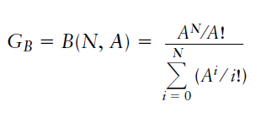
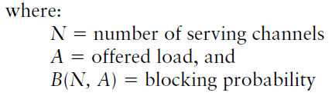
Cont...
Erlang B Formula provides an estimate of a call blocking probability used as a measure of grade of service in telephone systems when a mean traffic load of A Erlangs is applied to a trunked system of N channels.

Slide 9
Poisson’s Formula
The Poisson formula is used for designing trunks on a route for a given GoS.
The assumptions in Poisson’s formula are:
Traffic originates from an infinite number of independent sources
Traffic density per traffic source is equal
Lost calls are held (BCH)
A limited number of trunks or service channels exist

Slide 10

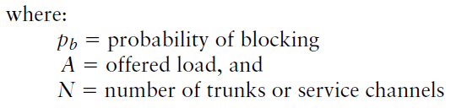

Slide 11
Erlang C Formula
The Erlang C formula assumes that a queue is formed to hold all requested calls that cannot be served immediately.
Customers who find all N servers busy join a queue and wait as long as necessary to receive service.
This means that the blocked customers are delayed. No server remains idle if a customer is waiting.

Slide 12
Cont...
The assumptions in the Erlang C formula are:
Traffic originates from an infinite number of traffic sources independently.
Lost calls are delayed (BCD).
Number of trunks or service channels is limited.
The probability of a user occupying a channel (called service time) is based on an exponential distribution.
Calls are served in the order of arrival.

Slide 13
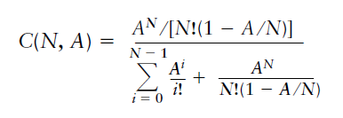
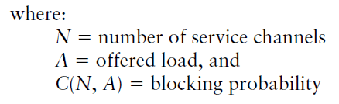

Slide 14
Example
How many mobile subscribers can be supported with 50 service channels at 2% GoS? Assume the average call holding time equals 120 seconds and the average busy hour call per subscriber is 1.2 calls per hour.

Slide 15
Solution
From the Erlang B table, for 50 channels with 2% blocking
Offered traffic = 40.257E
Then, carried traffic = 40.257x(1-0.02)=39.45E
Average traffic per user =1.2x120/3600=0.04E
No. of users=39.45/0.04=986Users

Slide 16
Example.
If there are 60 radio channels in a cell to handle all the calls and the average call holding time is 120 seconds, how many calls are handled in this cell with a GoS of 2%?
BCC
BCD
BCH
Solution: In class

